Slide 1


Slide 2


Slide 4
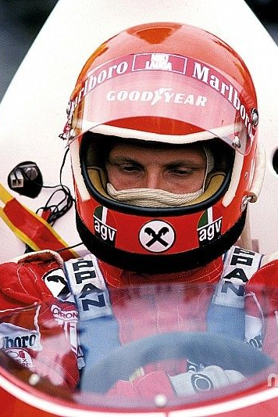

Dataset
Seasons
Constructor results
Constructor standings
Constructors
Drivers
Driver’s standings
Status
Races
Circuits
Qualifying
Lap times
Pit stops
Sprint results
Results
Seasons
Constructor results
Constructor standings
Constructors
Drivers
Driver’s standings
Status
Races
Circuits
Qualifying
Lap times
Pit stops
Sprint results
Results

Slide 5
Dataset
Race Id | Driver Id | Final Position | laps | Race Time | Status Id | Lap | Lap position | Lap time | Qualy position | q1 | q2 | q3 | year | Circuit Id | lat | lng | alt | Constructor Position | Full Name | Nationality Id
93 | 18 | 2 | 62 | 5189372 | 1 | 34 | 2 | 82784 |  |  |  |  |  |  |  |  |  |  | Jenson Button | 9
868 | 807 | 12 | 52 | 5159144 | 1 | 30 | 8 | 97891 | 9 | 106334 | 115556 | 114382 | 2012 | 9 | 52.0786 | -1.01694 | 153 | 5 | Nico Hülkenberg | 20
1033 | 826 |  |  |  |  | 40 | 12 | 81386 | 17 | 76204 | 76204 | 76204 | 2020 | 11 | 47.5789 | 19.2486 | 264 | 8 | Daniil Kvyat | 35
230 | 30 | 1 | 65 | 7189307 | 1 | 9 | 2 | 109945 | 3 | 81587 | 81587 | 81587 | 1996 | 4 | 41.57 | 2.26111 | 109 | 3 | Michael Schumacher | 20
13 | 4 | 5 | 53 | 4640888 | 1 | 47 | 6 | 86126 | 8 | 83708 | 83497 | 85072 | 2009 | 14 | 45.6156 | 9.28111 | 162 | 6 | Fernando Alonso | 37
979 | 838 |  |  |  |  | 59 | 10 | 82570 | 9 | 78479 | 78000 | 77894 | 2017 | 11 | 47.5789 | 19.2486 | 264 | 4 | Stoffel Vandoorne | 7
42 | 20 | 8 | 73 | 5537665 | 1 | 39 | 10 | 74709 | 7 | 72711 | 72644 | 73513 | 2007 | 19 | 39.795 | -86.2347 | 223 | 9 | Sebastian Vettel | 20
167 | 65 |  |  |  |  | 41 | 5 | 73894 |  |  |  |  |  |  |  |  |  |  | Johnny Herbert | 9
932 | 807 |  |  |  |  | 30 | 9 | 79631 | 7 | 76186 | 75706 | 75614 | 2015 | 7 | 45.5 | -73.5228 | 13 | 5 | Nico Hülkenberg | 20
138 | 22 | 1 | 53 | 4579982 | 1 | 16 | 1 | 83937 |  |  |  |  |  |  |  |  |  |  | Rubens Barrichello | 8

Slide 6
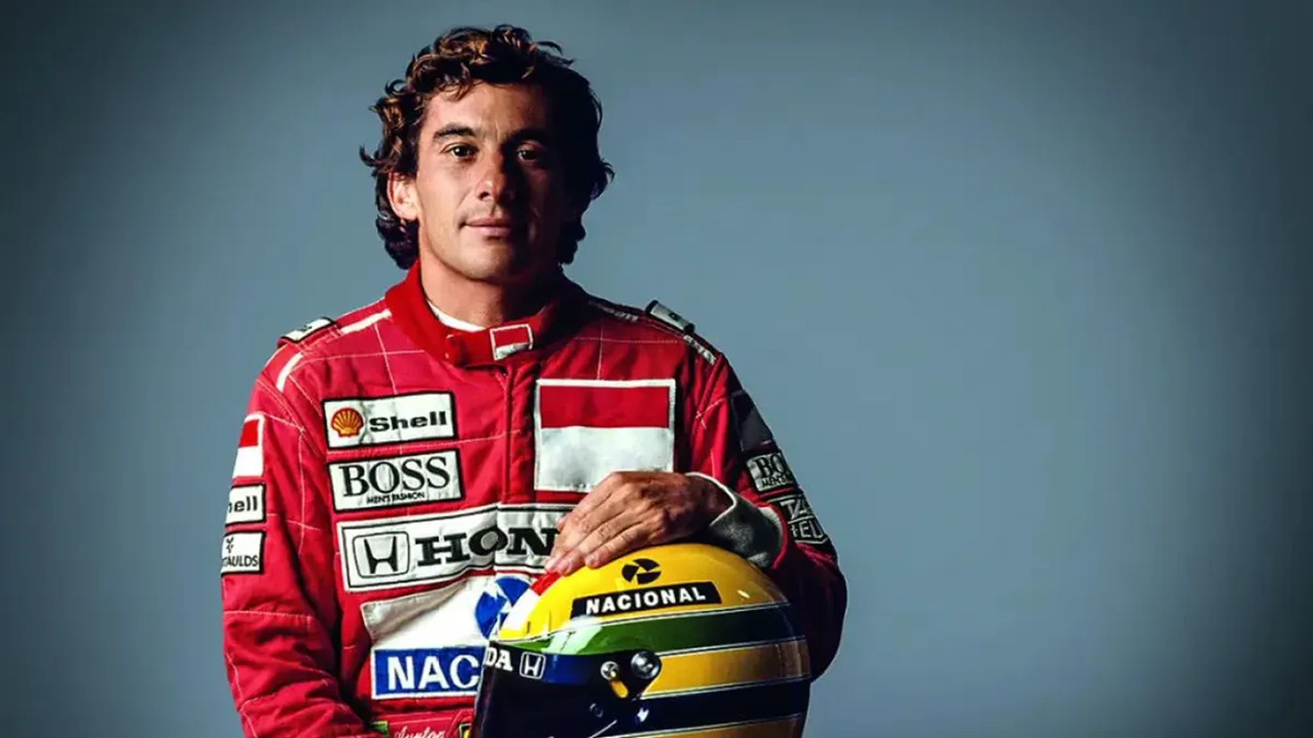
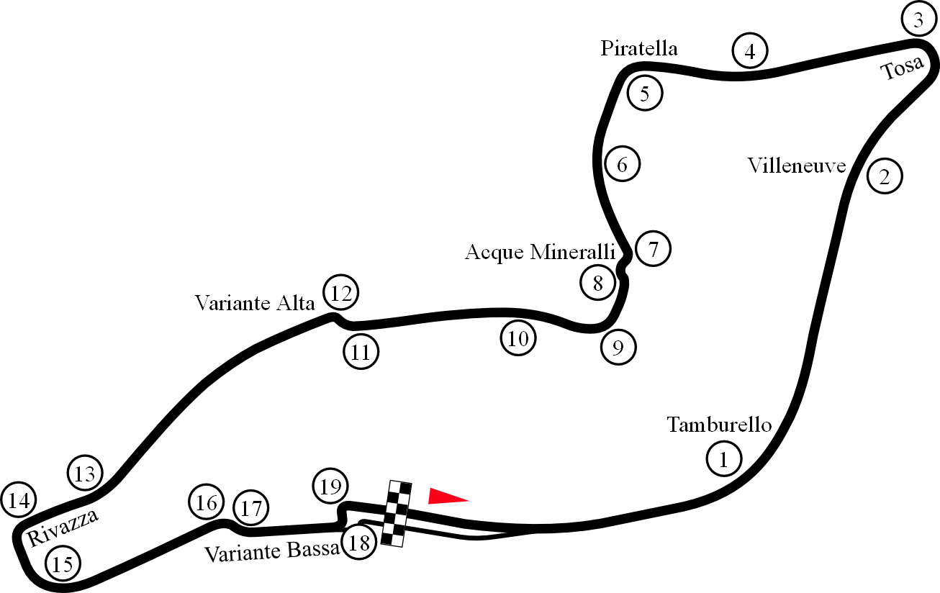

Slide 7
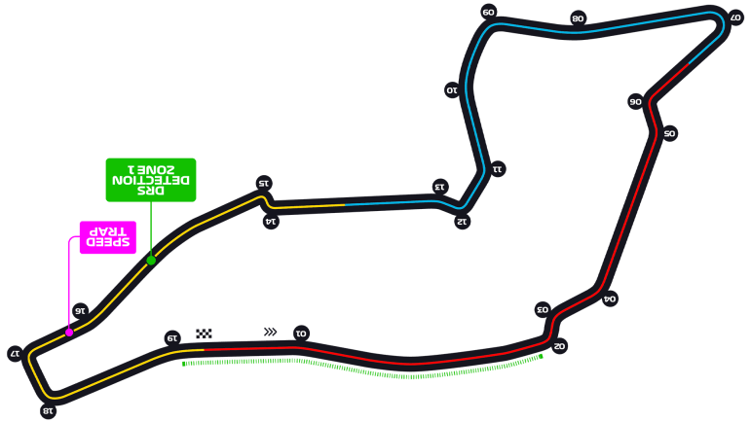

Slide 8
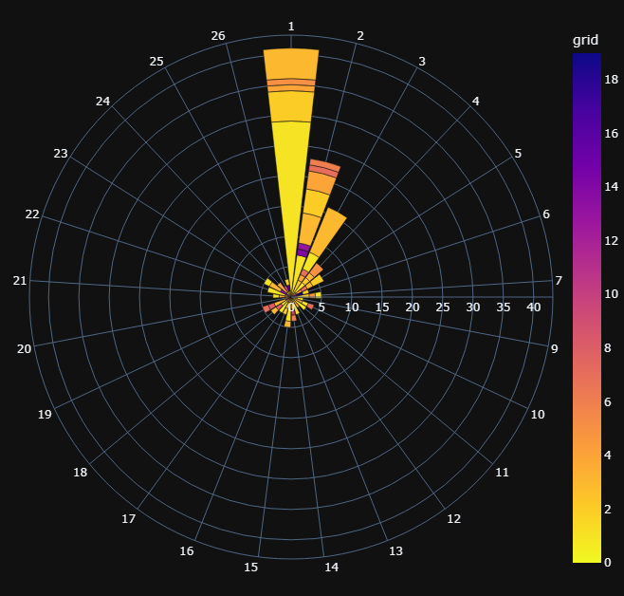
Ayrton’s results per final Position

Slide 9
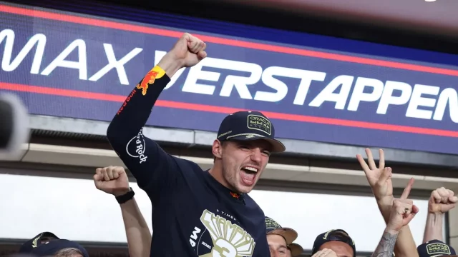

Slide 10
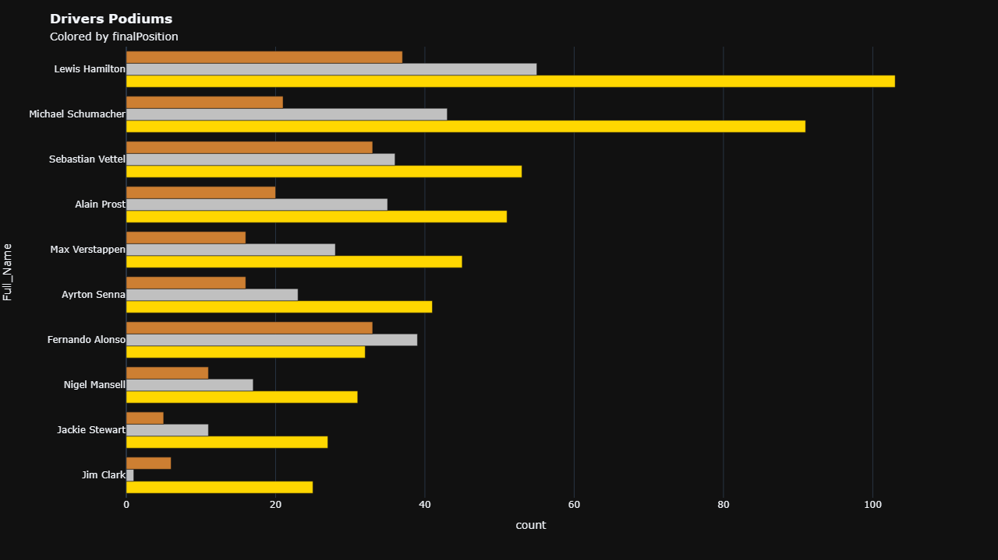

Slide 11
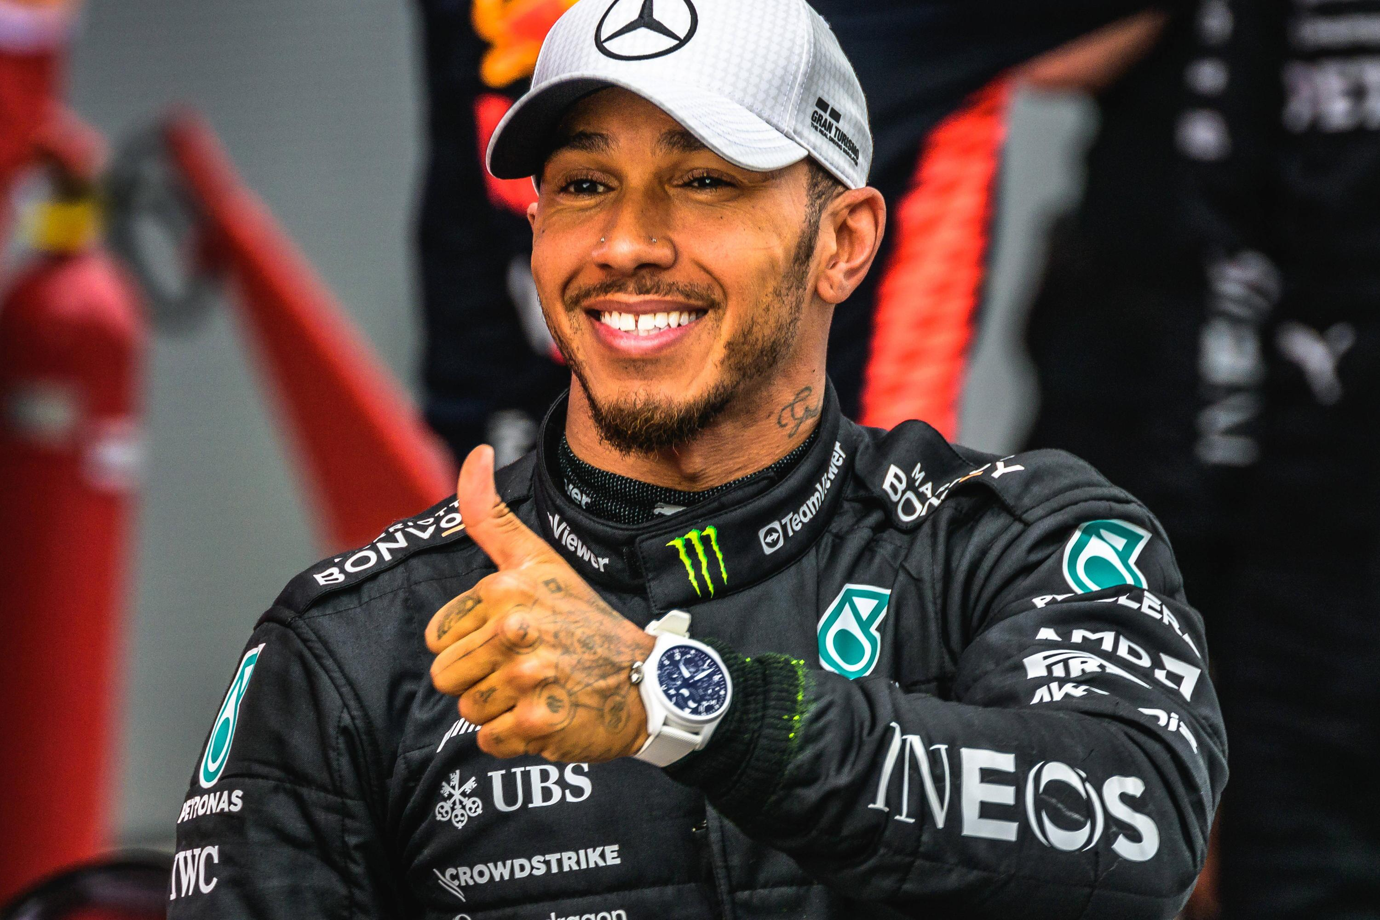

Slide 12
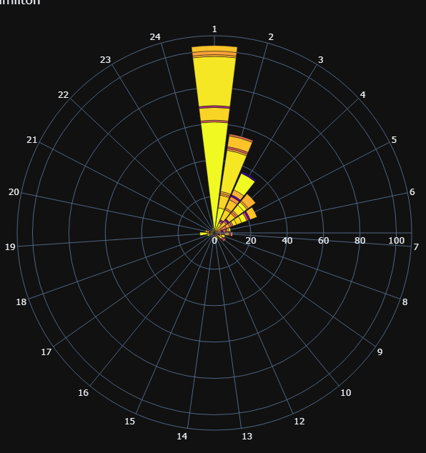
Hamilton’s results per final position

Slide 13
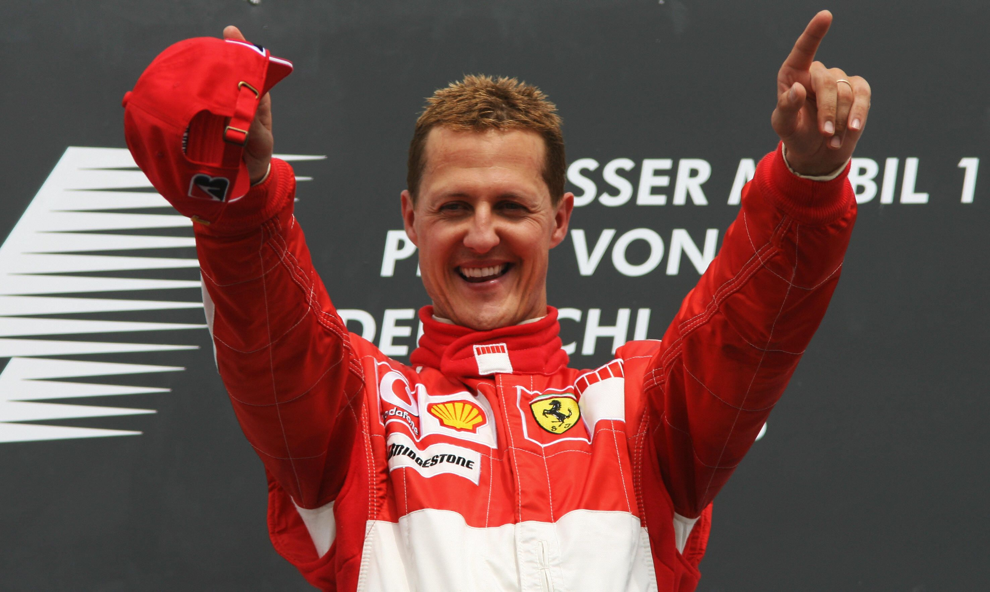

Slide 14
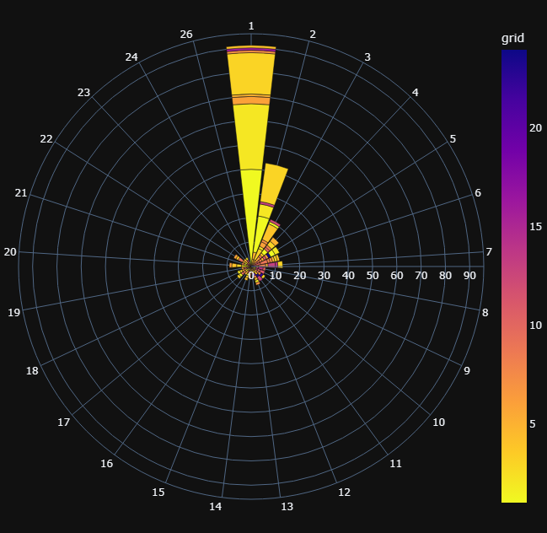
Schumacher’s results per final position

Slide 15
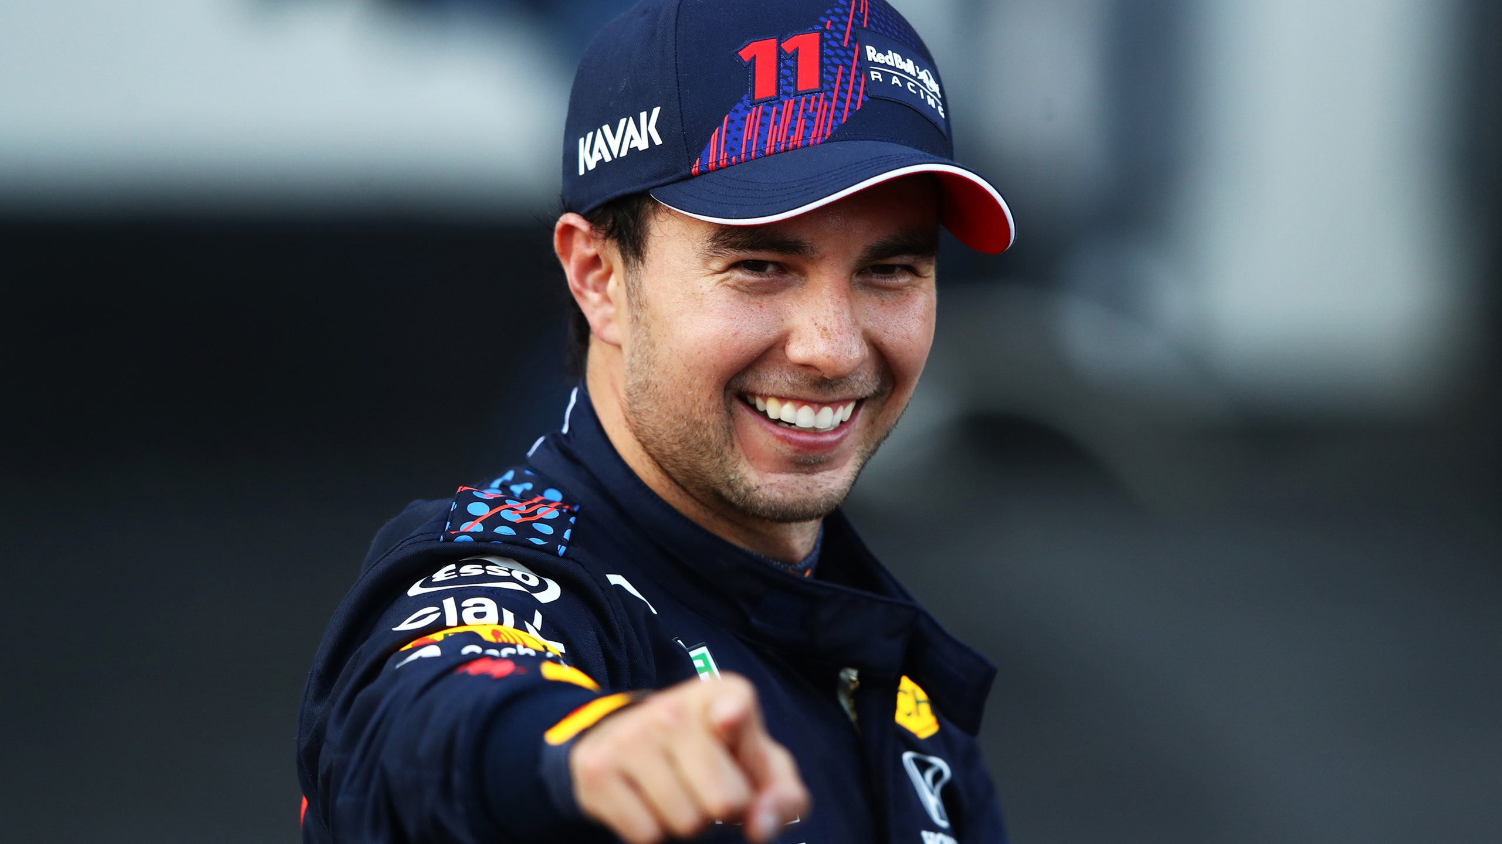

Slide 16
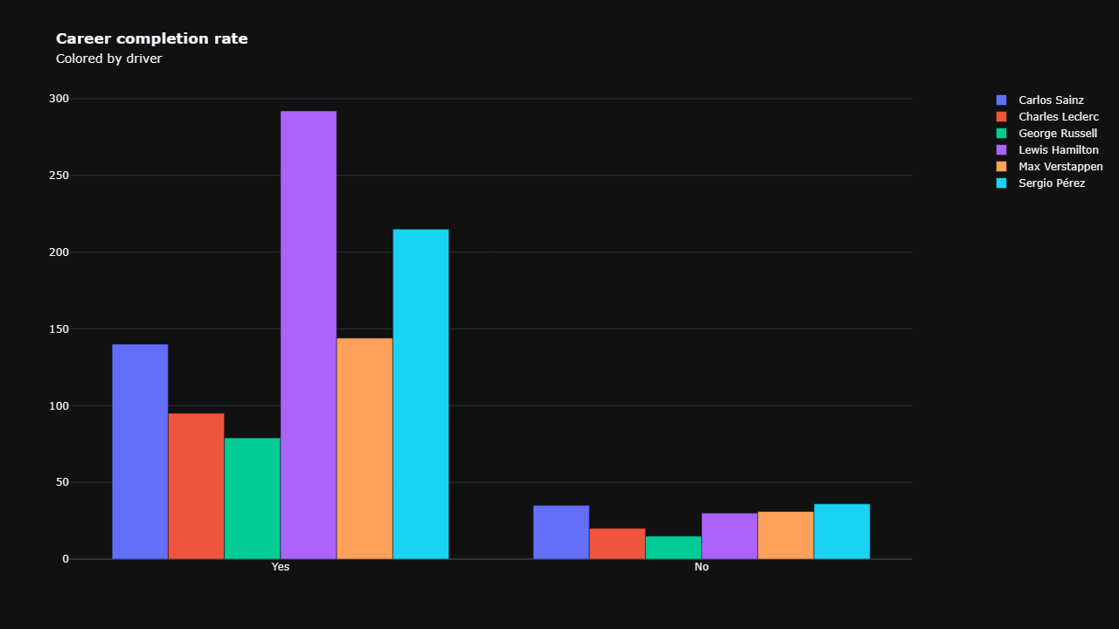

Slide 17
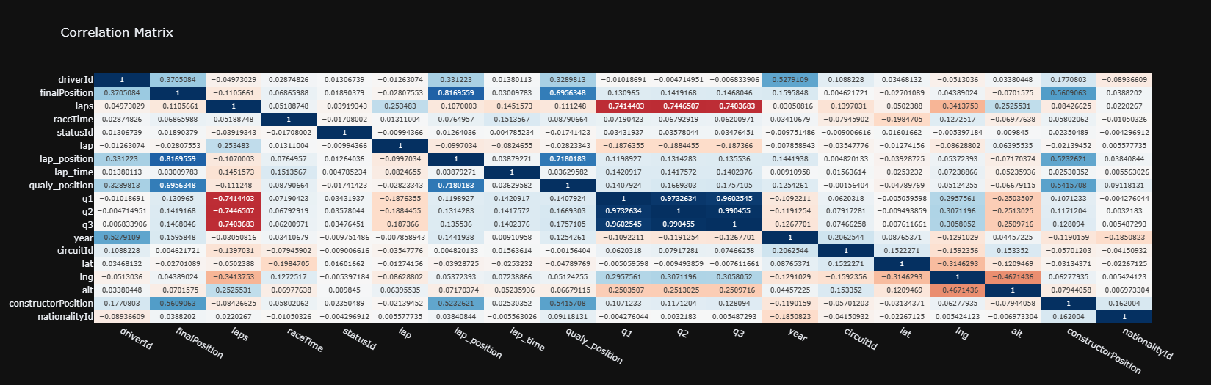
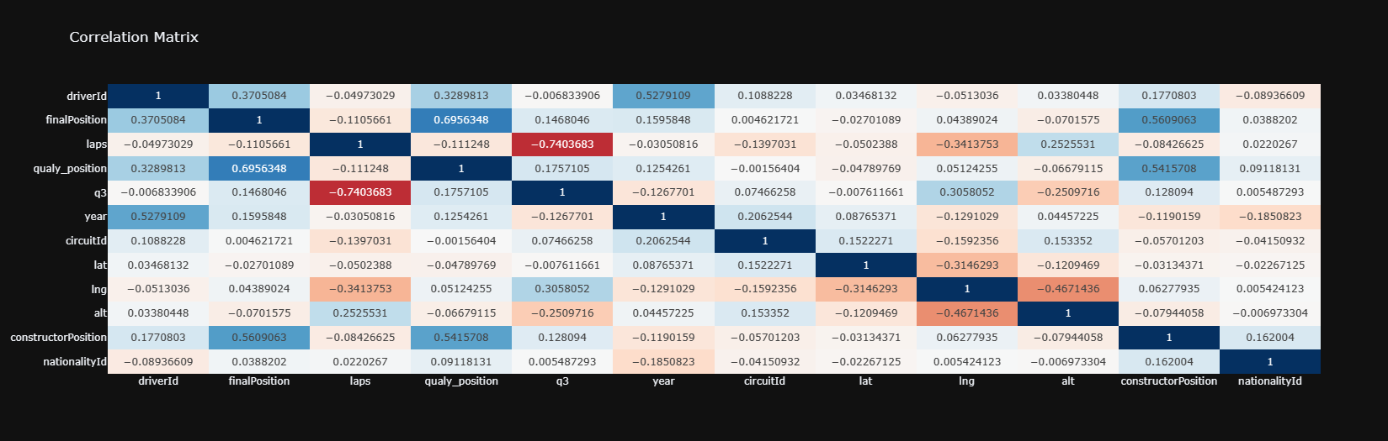

Slide 18
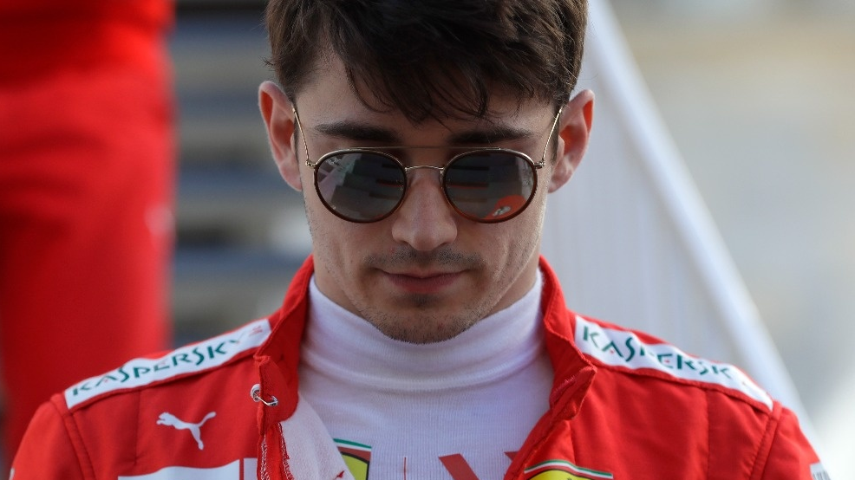
Models
Model | Accuracy
SVC | 0.6657
RFC | 1
KNN | 1
Model | MSE | R2
SVR | 4.389642 | 0.684928
DT | 21.128154 | -0.516499
RFR | 0.41585 | 0.970152
Model | MSE | R2
RFR | 0.41585023 | 0.97015185
RFC | 0 | 1

Slide 19
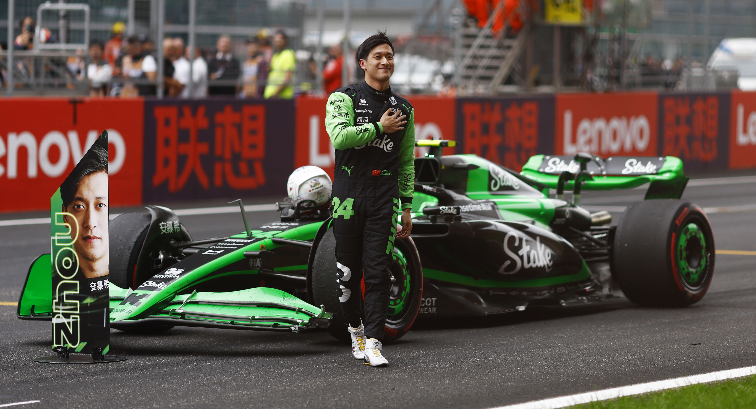
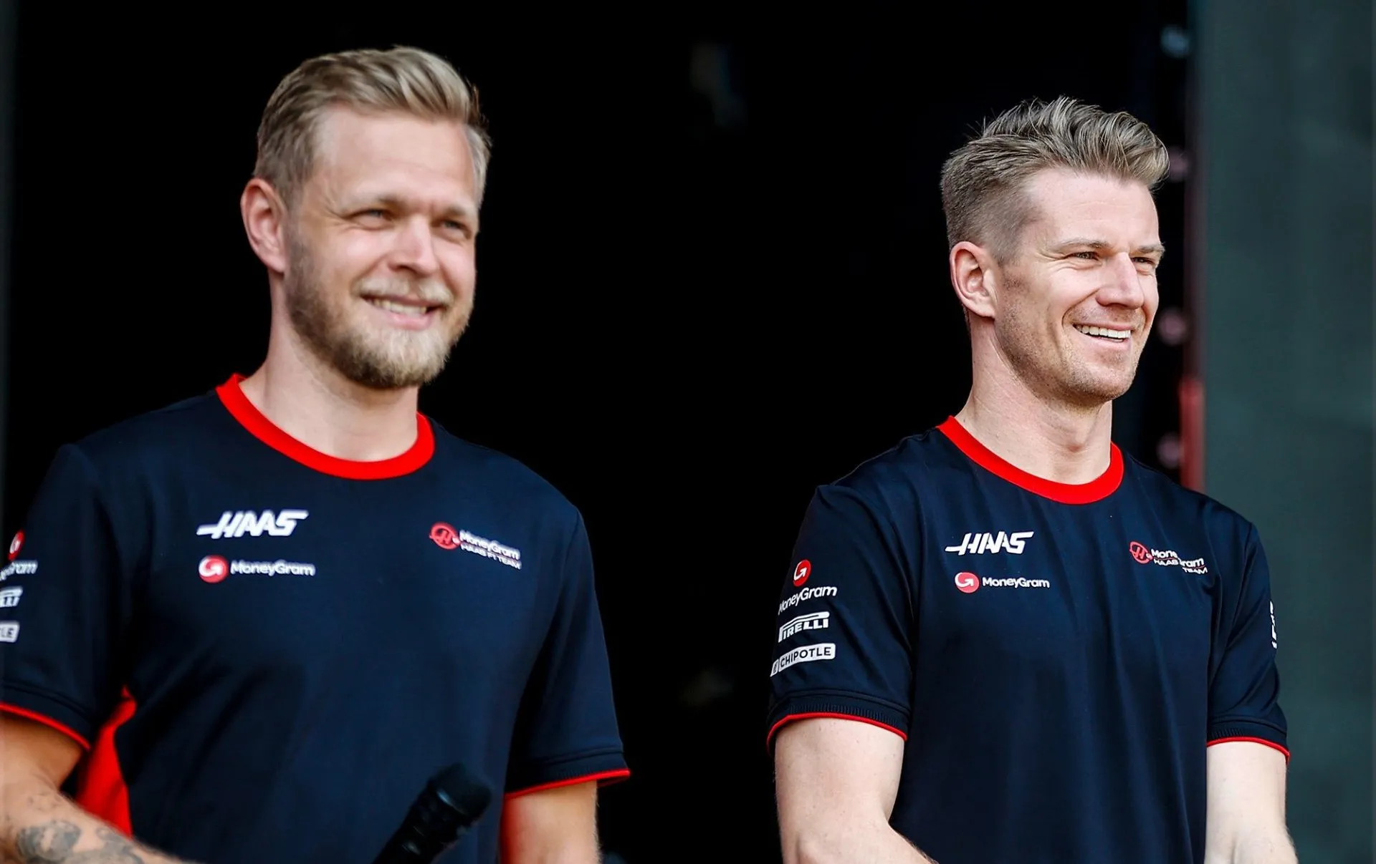
Before Quali Prediction
Predicted Position | Driver | Grand Prix
1 | Max Verstappen | Autodromo Enzo e Dino Ferrari 2024
2 | Lewis Hamilton | Autodromo Enzo e Dino Ferrari 2024
3 | Sergio Pérez | Autodromo Enzo e Dino Ferrari 2024
4 | George Russell | Autodromo Enzo e Dino Ferrari 2024
5 | Carlos Sainz | Autodromo Enzo e Dino Ferrari 2024
6 | Charles Leclerc | Autodromo Enzo e Dino Ferrari 2024
7 | Fernando Alonso | Autodromo Enzo e Dino Ferrari 2024
8 | Alexander Albon | Autodromo Enzo e Dino Ferrari 2024
9 | Lando Norris | Autodromo Enzo e Dino Ferrari 2024
10 | Guanyu Zhou | Autodromo Enzo e Dino Ferrari 2024
Predicted Position | Driver | Grand Prix
11 | Yuki Tsunoda | Autodromo Enzo e Dino Ferrari 2024
12 | Valtteri Bottas | Autodromo Enzo e Dino Ferrari 2024
13 | Lance Stroll | Autodromo Enzo e Dino Ferrari 2024
14 | Oscar Piastri | Autodromo Enzo e Dino Ferrari 2024
15 | Daniel Ricciardo | Autodromo Enzo e Dino Ferrari 2024
16 | Nico Hülkenberg | Autodromo Enzo e Dino Ferrari 2024
17 | Esteban Ocon | Autodromo Enzo e Dino Ferrari 2024
18 | Pierre Gasly | Autodromo Enzo e Dino Ferrari 2024
19 | Kevin Magnussen | Autodromo Enzo e Dino Ferrari 2024
20 | Logan Sargeant | Autodromo Enzo e Dino Ferrari 2024

Slide 20
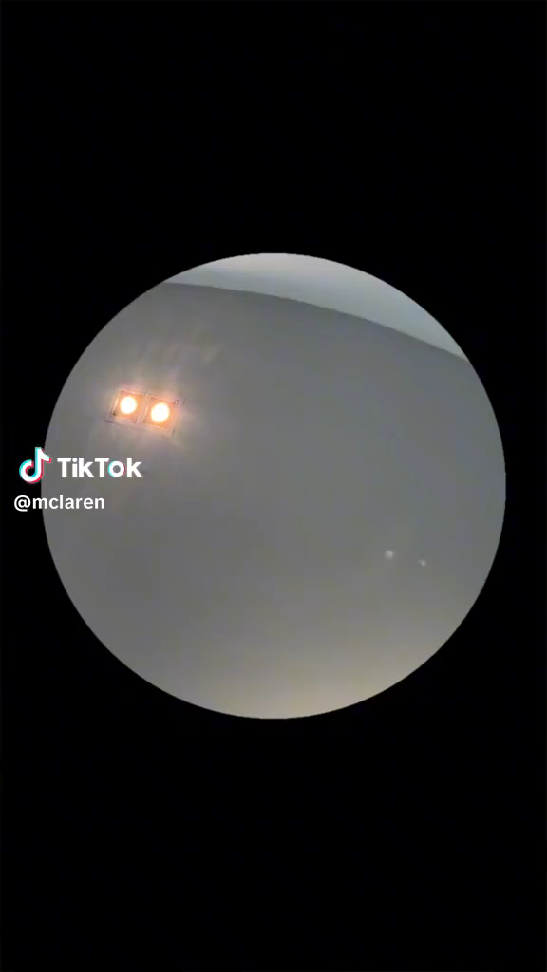
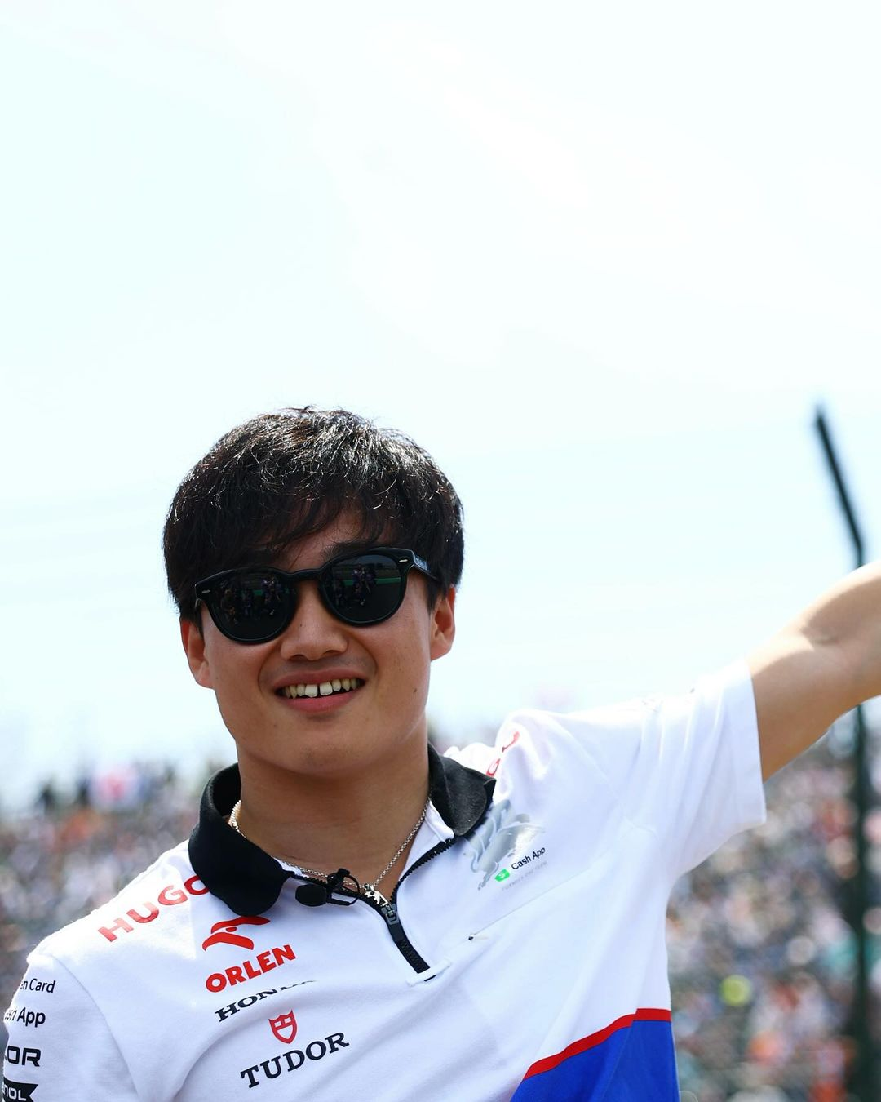
After Quali Prediction
Predicted Position | Driver | Grand Prix
1 | Max Verstappen | Autodromo Enzo e Dino Ferrari 2024
2 | Sergio Pérez | Autodromo Enzo e Dino Ferrari 2024
3 | Charles Leclerc | Autodromo Enzo e Dino Ferrari 2024
4 | Lewis Hamilton | Autodromo Enzo e Dino Ferrari 2024
5 | Oscar Piastri | Autodromo Enzo e Dino Ferrari 2024
6 | George Russell | Autodromo Enzo e Dino Ferrari 2024
7 | Alexander Albon | Autodromo Enzo e Dino Ferrari 2024
8 | Yuki Tsunoda | Autodromo Enzo e Dino Ferrari 2024
9 | Carlos Sainz | Autodromo Enzo e Dino Ferrari 2024
10 | Guanyu Zhou | Autodromo Enzo e Dino Ferrari 2024
Predicted Position | Driver | Grand Prix
11 | Fernando Alonso | Autodromo Enzo e Dino Ferrari 2024
12 | Lando Norris | Autodromo Enzo e Dino Ferrari 2024
13 | Nico Hülkenberg | Autodromo Enzo e Dino Ferrari 2024
14 | Daniel Ricciardo | Autodromo Enzo e Dino Ferrari 2024
15 | Lance Stroll | Autodromo Enzo e Dino Ferrari 2024
16 | Esteban Ocon | Autodromo Enzo e Dino Ferrari 2024
17 | Valtteri Bottas | Autodromo Enzo e Dino Ferrari 2024
18 | Pierre Gasly | Autodromo Enzo e Dino Ferrari 2024
19 | Kevin Magnussen | Autodromo Enzo e Dino Ferrari 2024
20 | Logan Sargeant | Autodromo Enzo e Dino Ferrari 2024

